Slide 1

Day 1: Microprocessors, Coding and Energy

Slide 2
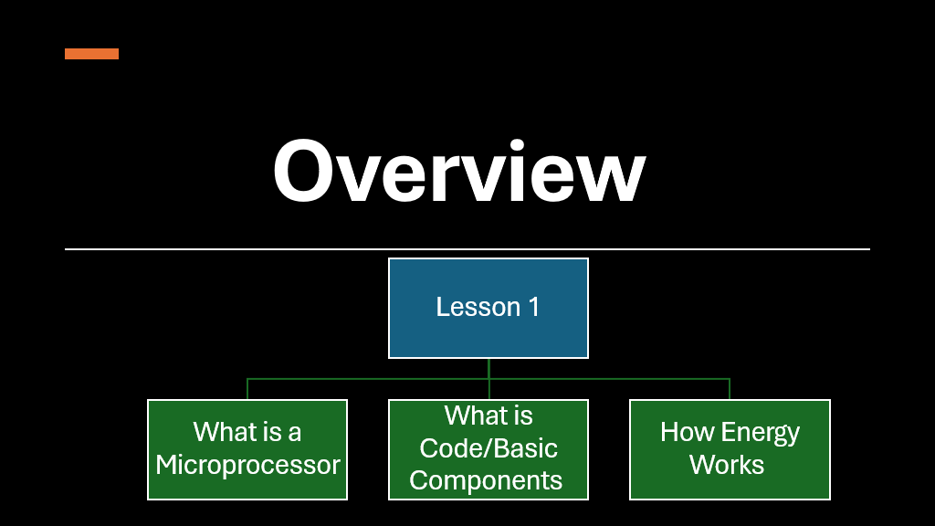

Slide 3
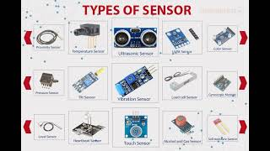
What is a Microprocessor?

Slide 4
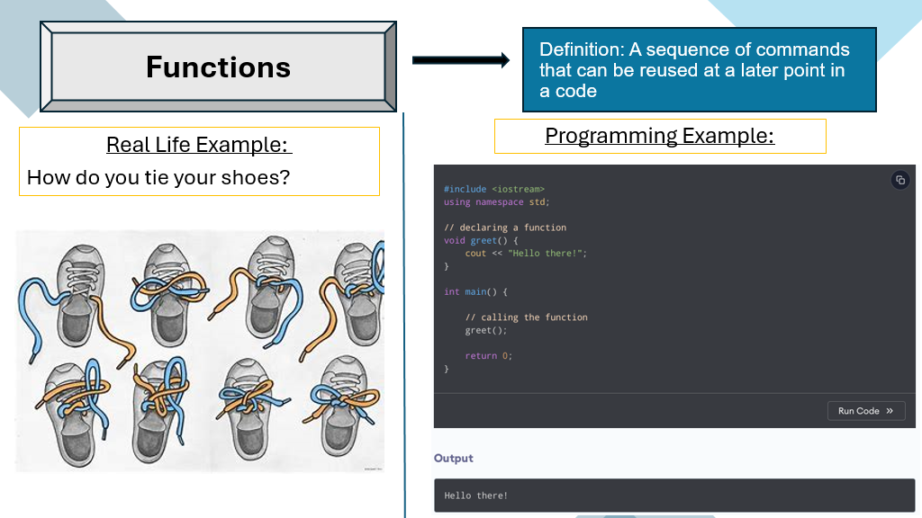

Slide 5
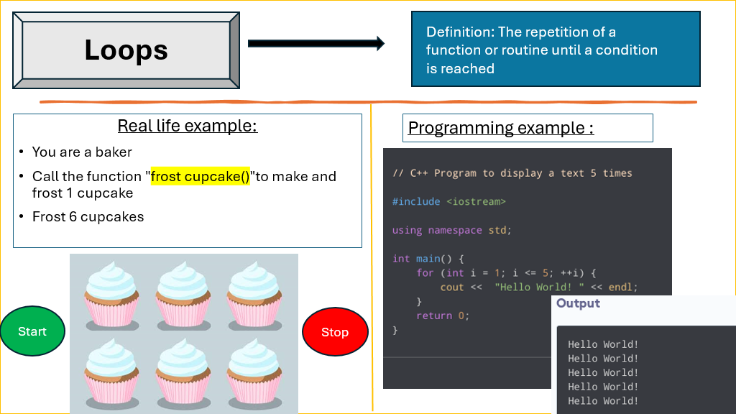

Slide 6
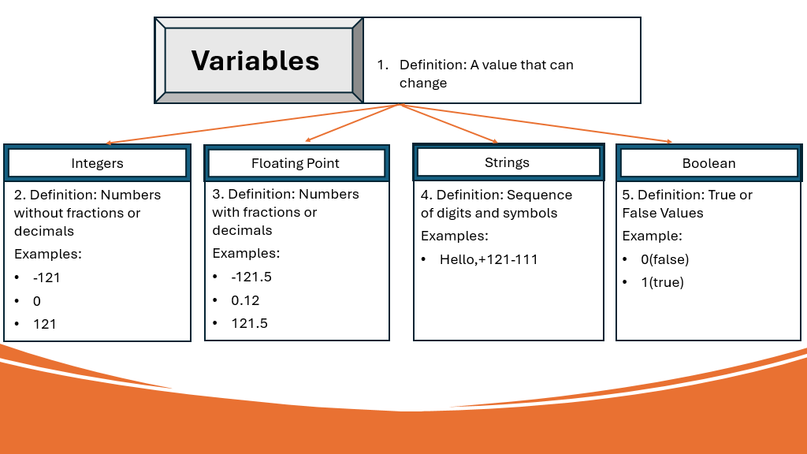

Slide 7
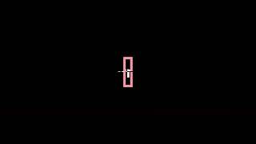
Electrical Terms

Slide 8
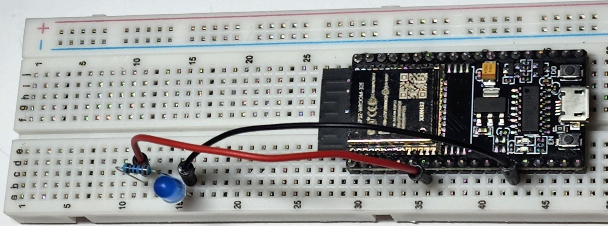
CIRCUIT BUILDING
Lesson 1 Activity

Slide 9
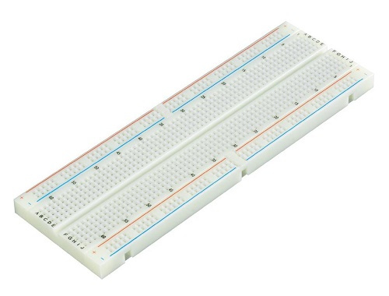
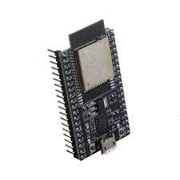
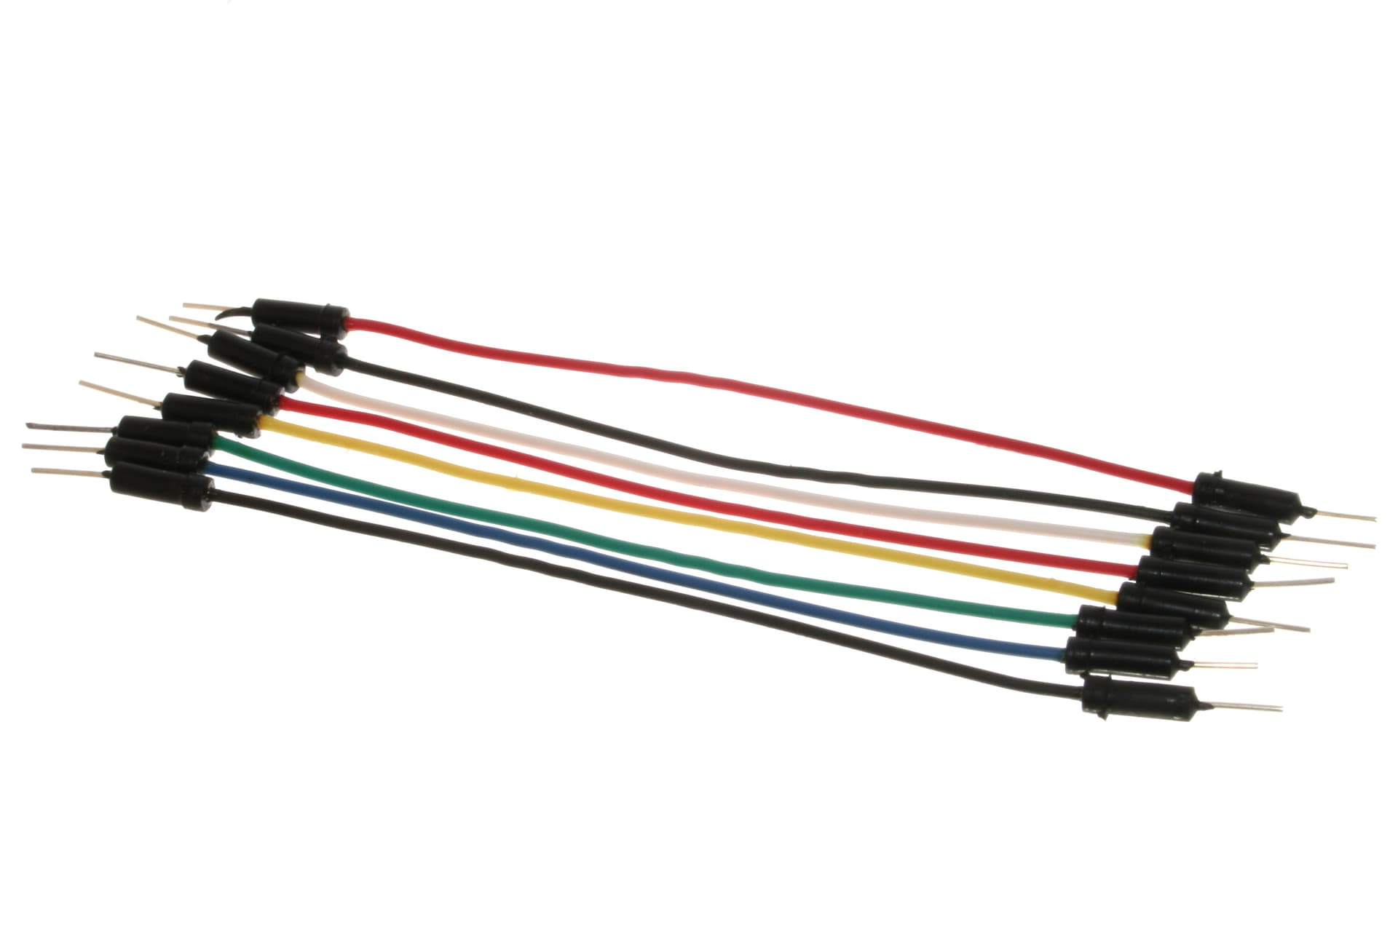
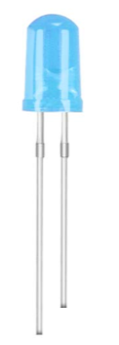
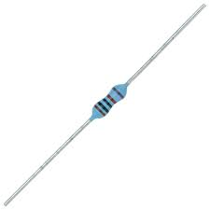
COMPONENTS NEEDED
 | BREADBOARD | ESP32 | WIRES
 | LED |  | 220Ω RESISTOR

Slide 10
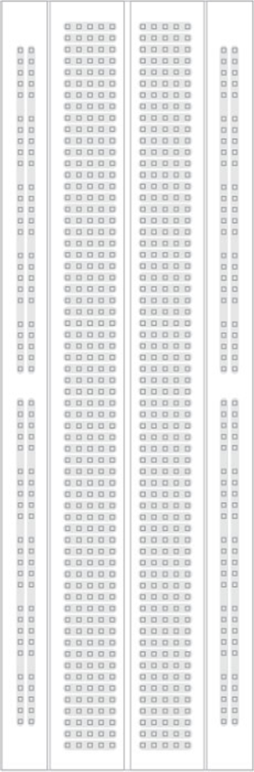
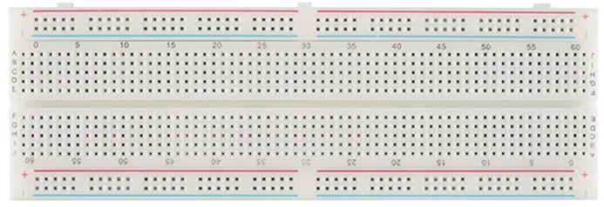
BREADBOARD
A breadboard is used to make connections between components of the circuits.
There are metal strips inside of the breadboard

Slide 11
BREADBOARD
Power Rails run along the sides of the breadboard.
Like their name, they are usually used to make connections related to the power (energy) across the circuit
The side by the blue rail labeled with a negative symbol
( - )
is used for the ground
The side by the red rail labeled with a positive symbol
( + )
is used for the
voltage

Slide 12
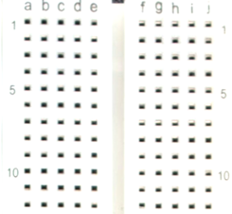
BREADBOARD
Terminal Strips are the middle rows on the breadboard. These strips make connections across the five holes of each row.
These are usually used to make connections between components of the circuit
The columns are labeled a through j
Every five rows are labeled with their number

Slide 13
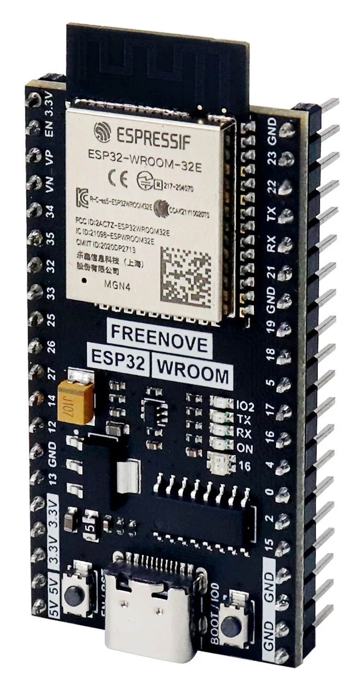
ESP32 MICROPROCESSOR
These are the Microprocessors we will be using for our lessons
A Microprocessor can quickly process instructions to complete tasks.
We will deliver these instructions through code

Slide 14
LED
Light Emitting Diode

Slide 15
LED
The Long Pin is the positive side + (Anode)
Which can take energy and signals
As energy jumps from one side to the other, some is dispersed as light
Creating the glow we see from the LED
The Short Pin is the negative side -
(Cathode)
Which connects to the ground

Slide 16

LED
The Long Pin is the positive side + (Anode)
Which can take energy and signals
The Long Pin is the positive side + (Anode)
Which can take energy and signals
The Long Pin is the positive side + (Anode)
Which can take energy and signals
The Short Pin is the negative side -
(Cathode)
Which connects to the ground

Slide 17
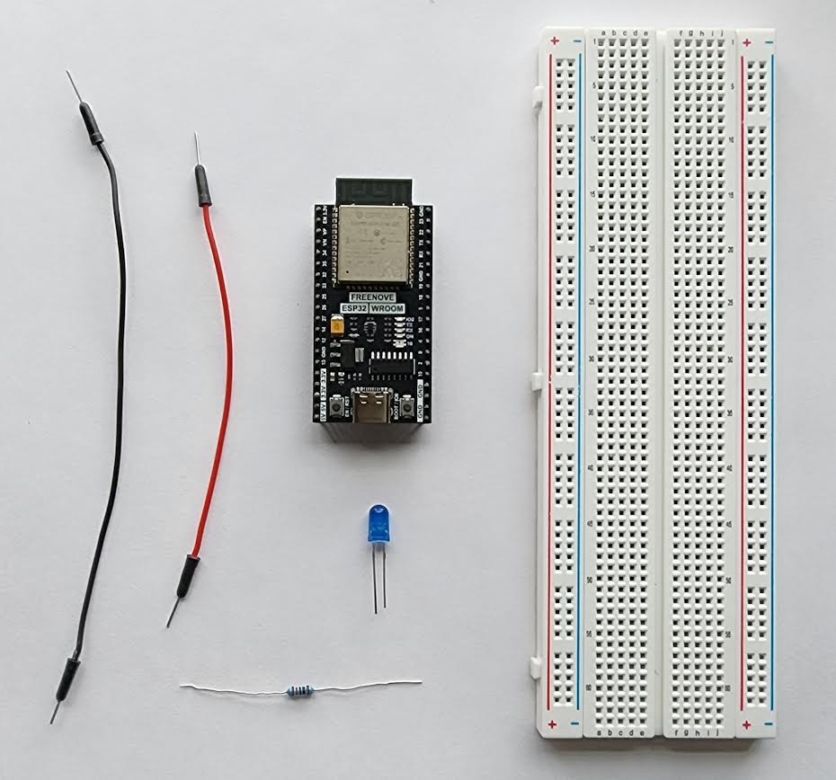
CONSTRUCTION

Slide 18
REMEMBER:
The Terminal Strips of the middle rows on the breadboard make connections through the rows of 5 on either side
Not across all 10

Slide 19
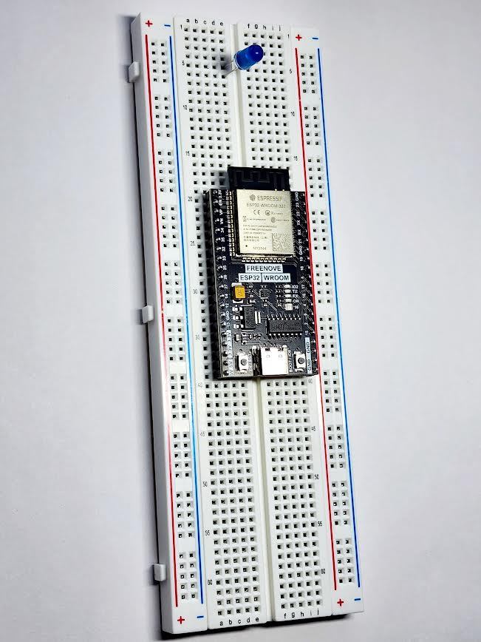
Place the LED and ESP32 onto the Breadboard

Slide 20
With the board title facing upright towards you, leave room on the left side for pin connections

Slide 21
For the LED Keep in mind which row has the long pin and which row has the short pin

Slide 22
You can use the row number to keep track
In this case: Row 5 is the
Row 6 is the
ANODE
CATHODE

Slide 23
Now that our components are on the board
Lets Connect Them!

Slide 24
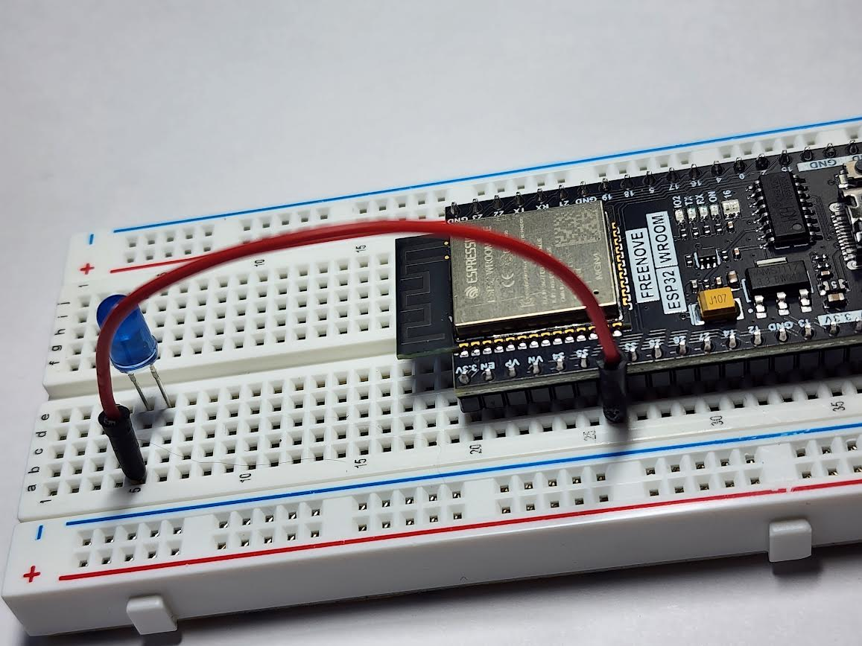
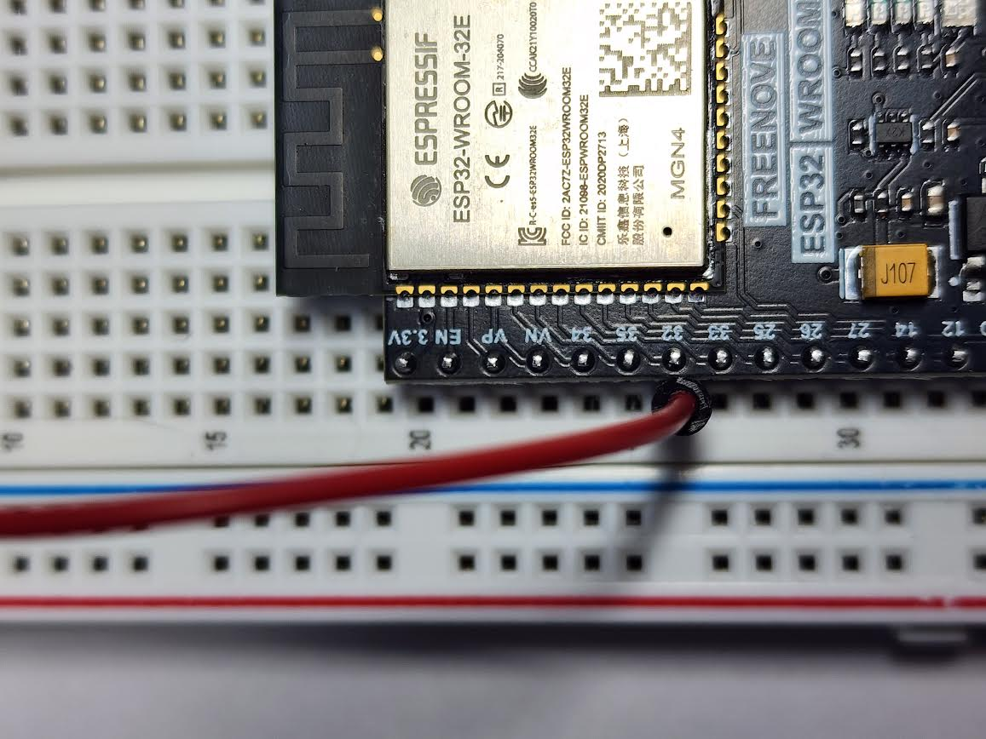
ANODE
32

Slide 25
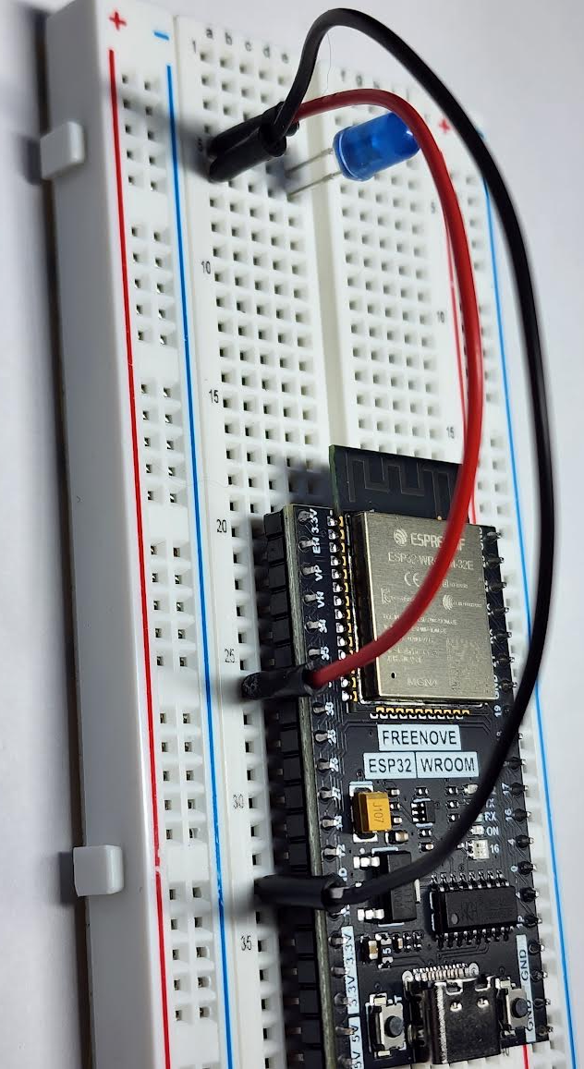
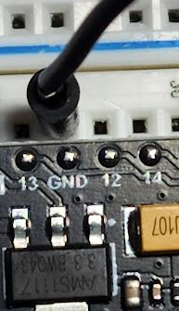
GND
CATHODE

Slide 26
Since the Pin numbers on the ESP 32 don’t have decimals
The value that will be stored is an:
Let's start by labeling the pin we have connected our led component to with a variable
integer (int)
Next, we give the name we will use to refer to the value by
We will then tell the computer
“this will be equal to this”
with an
int
ledPin
=
32
;
equal sign ( = )
Now add the value that will be held on the other side
Finally, end the line of code with a semicolon

Slide 27
Instructions (Code) placed within the void setup
Will be completed once
As soon as we run the program
Let's tell the microprocessor how we want the pin connected to the LED to be used
pin
Will be in the
Mode
of an
INPUT or OUTPUT
pinMode
declares whether the:
void setup (){ }
pinMode(ledPin,OUTPUT);
Since we want this pin to give out power and instructions, we will set the Mode to
OUTPUT
And end the line of code with a semicolon

Slide 28
Instructions (Code) placed within the void loop
Will be completed once
As soon as we run the program
Let's create the instructions we want our microprocessor to continuously run
void loop(){
}
void loop(){
}
digitalWrite
Sets a pin to either HIGH or LOW
Since the pin is set to Output, it will Output energy completely (HIGH) Or not at all (LOW)
delay creates a pause in your code by making the program wait on that line for however many milliseconds are placed in the brackets

Slide 29
To make our LED Blink
We will need the light to turn on and off
Let's create the instructions we want our microprocessor to continuously run
Send voltage through the LED
Wait
void loop(){
}
Stop sending voltage through the LED
digitalWrite (ledPin, HIGH);
delay(1000);
Wait
digitalWrite (ledPin, LOW);
delay(1000);

Slide 30
Coding languages, like the C++ we are using, work with a specific Syntax ​
(rules for how the code needs to be arranged)​
just like how languages around the world have specific grammar rules​

Slide 31
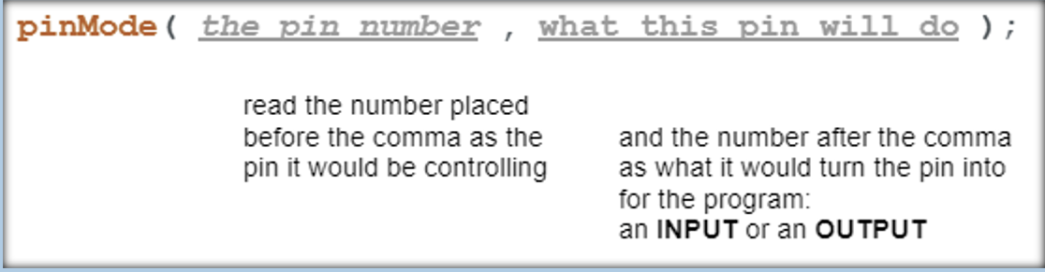
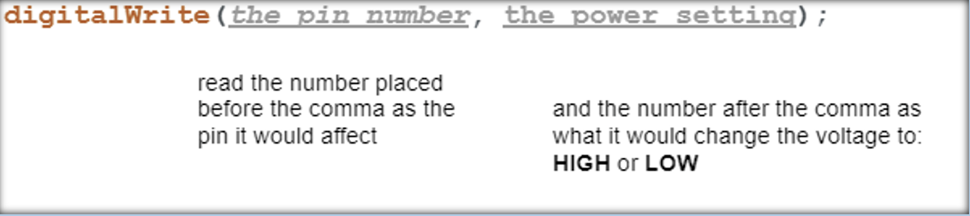
Within the functions pinMode and digitalWrite, their Arguments were written with a specific Syntax
Values placed in parentheses () after the function name​,
that the function uses​ to perform its task

Slide 32
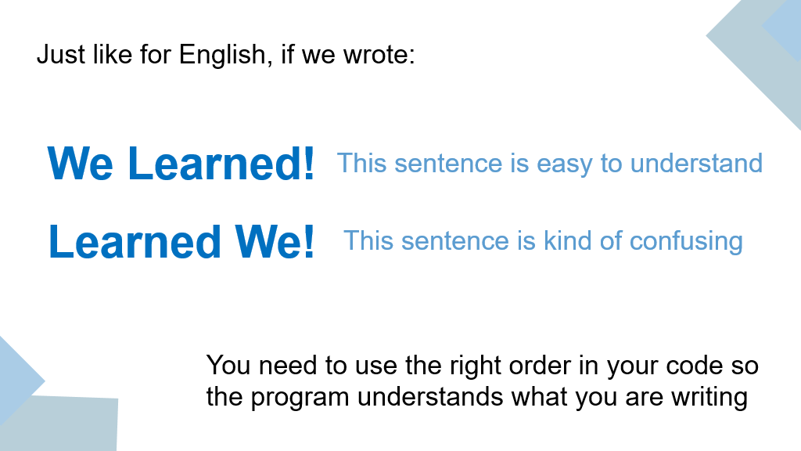

Slide 33
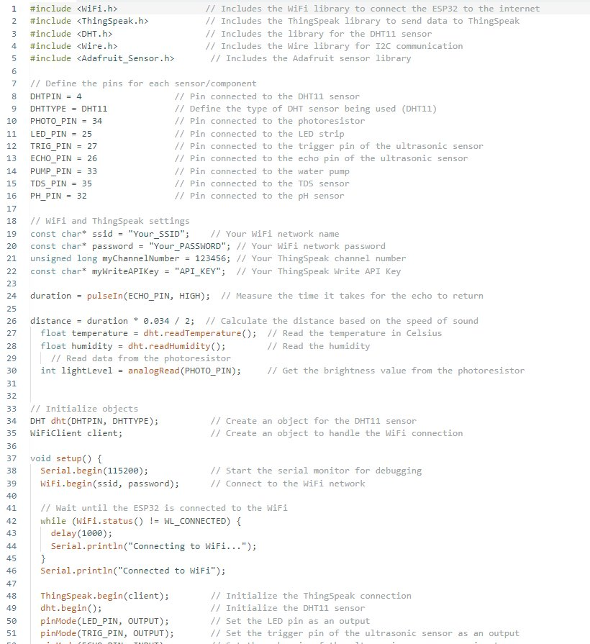
If we were working with several​
Pins​
Sensor readings
Or values that might change​
throughout the code, we could easily get the numbers confused.​
​
Placing values in variables, makes it easier for us to write and read our code​

Slide 34
CHALLENGE
CODE
Make the LED blink faster or slower
Change the blinking pattern
Hint: You can add more variations by adding to the code with the commands we learned today
CONSTRUCTION
Add a second LED to your circuit
Hint: Pay attention to which pin you
connect it to and your variable names
Notes:
Mention that they can copy and paste from code they

Slide 35

Topics/Definitions Covered
Microprocessors
ESP 32
Code
Functions
Loops
Variables
Integers
Floating Points
Strings
Booleans
Energy
Voltage
Current
Resistors
Code
Syntax
Arguments
PinMode
DigitalWrite
Void Loop
Void Setup
Delay

Slide 36
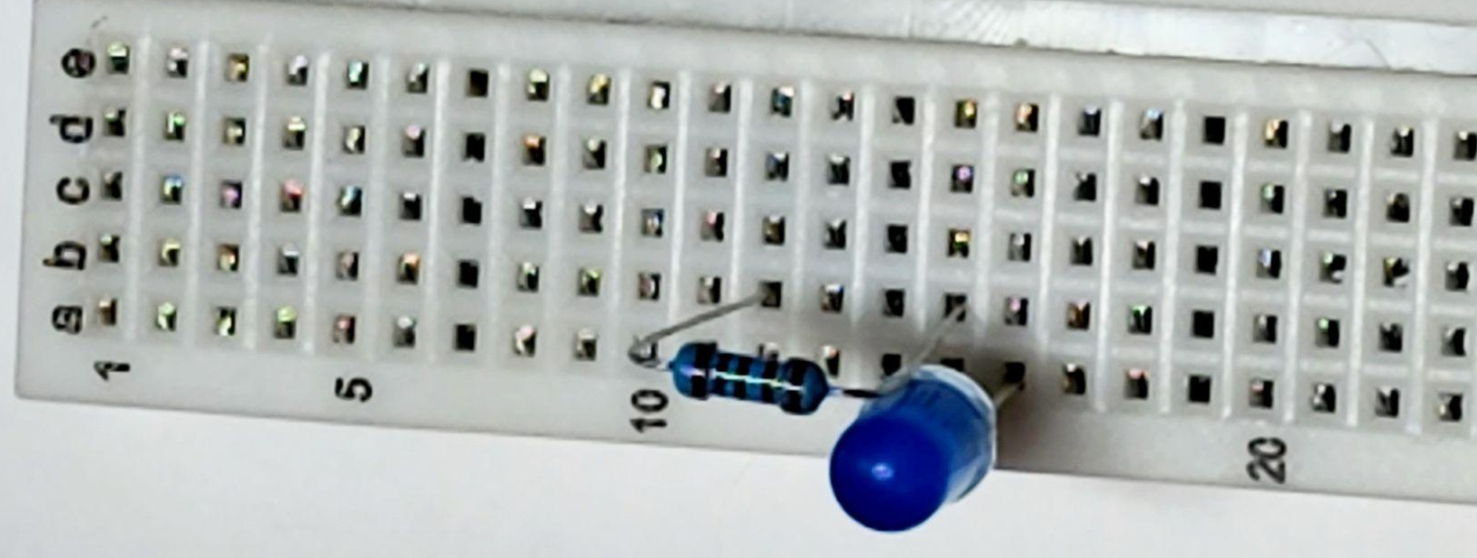
ARDUINO CONSTRUCTION
Place one leg of the 220Ω resistor
on the same row as the Anode of the LED
and the other on its own row
(b 15 to b 12)
This will slow down the current that will be sent from our ESP 32, to protect the LED from burning out

Slide 37
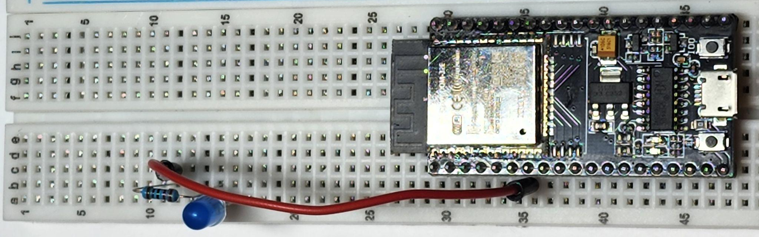
ARDUINO CONSTRUCTION
Connect the
free end of the resistor at b 12
to
GPIO 32 pin 32 on c 36
By placing a wire from
c 12
to
b 36
We are connecting the anode that can receive signals and electricity to the Pin that will output instructions

Slide 38
ARDUINO CONSTRUCTION
Connect the
free end of the resistor at b 12
to
GPIO 32 pin 32 on c 36
By placing a wire from
c 16
to
b 43
The energy can be dispersed
from the cathode
to the ground

Slide 39
ARDUINO CONSTRUCTION
Our circuit is now complete
The energy will be sent from pin 32
Travel through the red wire to the resistor
Slow down as it passes through the resistor
Jump from the LED’s Anode to the Cathode
Emitting light
Then finally get dispersed through the ground

